Slide 1

Simply the Best eSignatures
for Financial Institutions
Quick Start Webex Session
Welcome to our session. You may want to mute
your phone line until our Q & A section so as to mitigate background interference.

Slide 2
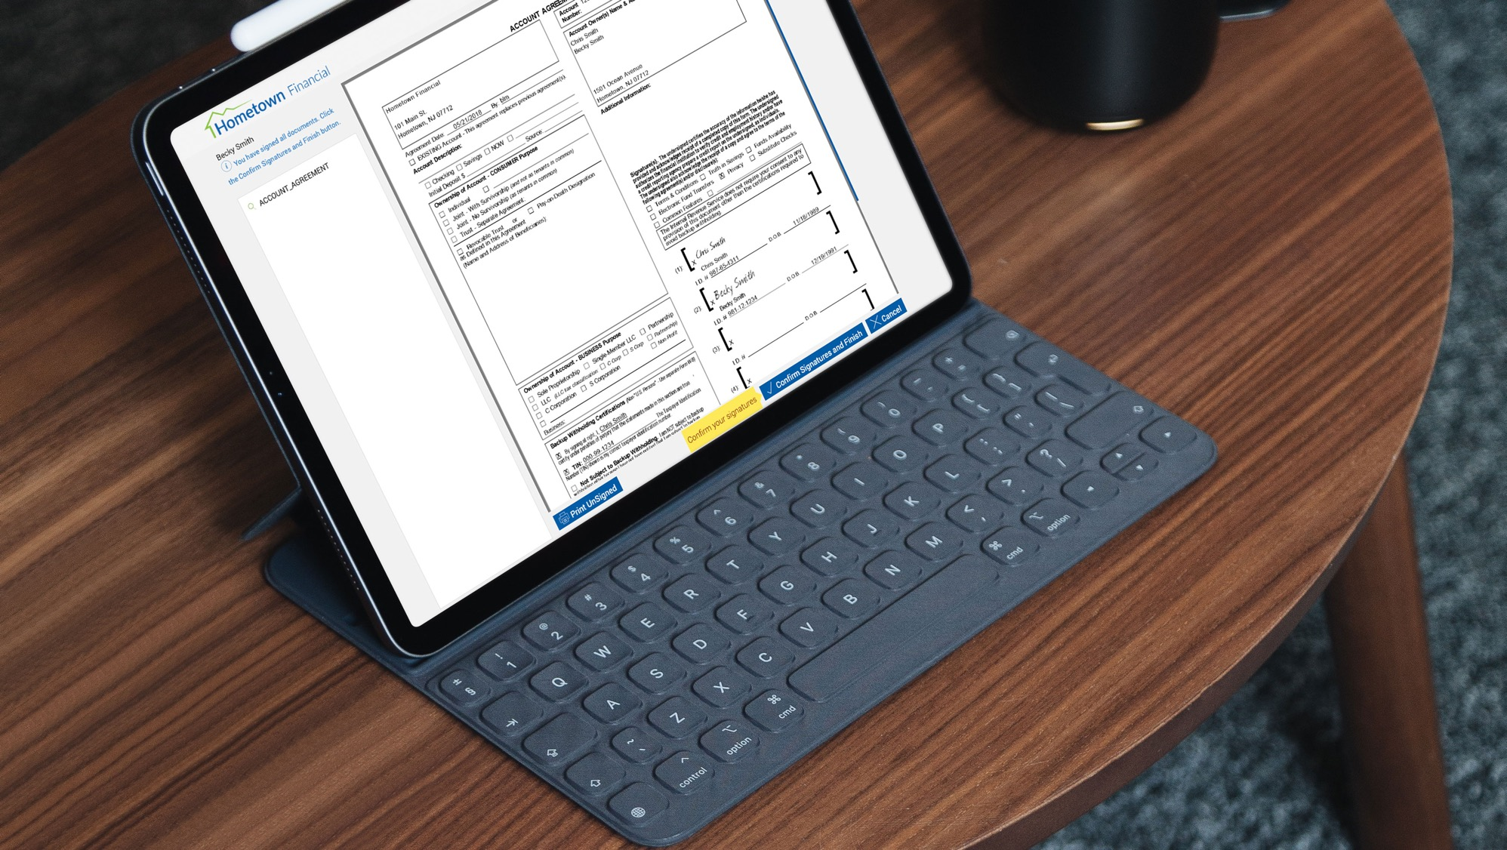
Welcome to our
eSign Quick Start Program

Slide 3

Today’s Session
Review Quick Start Program
eSign Process Flow Charts
Remote Signing Considerations
Training Agenda
Live Training and Demonstrations
Questions and Answers
Next Steps

Slide 4









IMM eSign Enterprise Platform
Submit to eSign
Session
Edit
eSign
Archive
Auto Login (SSO)
Auto Setup/Prep
Add Documents
Re-order Documents
Add Notes
In-Person
Remote
Blended Combination
Indexed PDFs
Audit Trails

Slide 5

Quick Start eSign Program
Enables Sending Documents for Electronic Signature
  Rapid Deployment Model
Provides the Ability:
  Upload Document(s)
  Designate Recipients
  Tag/Setup Document(s) for Signing
  Send
After Documents Signed by Consumer:
  Email Notification back to Sender (FI employee)
  Completed Documents Can Be Downloaded,
  Printed, or Viewed by Employee
Migration to Full IMM eSign Enterprise Available
Access to IMM Support Center following Training Session

Slide 6
Ad-Hoc Processing
Enter Signer(s) Information
Tag/Define
Document
Authentication
& Consent

Slide 7
Send via Pre-Established Template
Template
Authentication
& Consent

Slide 8
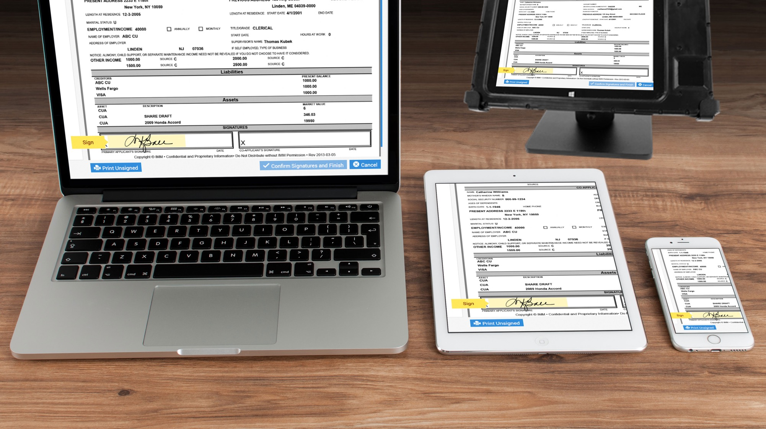
Easy Remote Document Signing

Slide 9
Remote Signer Authentication
+
Email
Password
KBA
Phone

Slide 10
Product Review Agenda
Review Portal Interface and Navigation
Sending simple one-time (Ad-hoc) document
Sending ad-hoc document with fillable fields
Creating reusable template
  Document to be filled-in and signed
Creating form field template
  Pre-populated document only to be signed
Sending from template
  Reusable document template
  Form field template
Creating Users and Roles
Portal Settings and Customization
Next Steps

Slide 11

Live System Review

Slide 12
Quick Start Resource Center
Navigate to:
www.immonline.com/quick-start/resources
This page contains:
Program Presentation and Demonstration
  PPT Deck for Presentation
Training Session Recording
  PPT Deck from Training Session

Slide 13
Review Topical Videos Part 1
Tutorial Videos
Quick Start (Ad-hoc) Portal Administration
Global settings:
https://helpx.adobe.com/sign/how-to/adobe-learn-global-settings.html
Add Users to your account:
https://helpx.adobe.com/sign/how-to/adobe-add-users-to-account.html
Set up profile preferences:
https://helpx.adobe.com/sign/how-to/adobe-configure-your-account.html
Share Account access:
https://helpx.adobe.com/sign/how-to/adobe-share-account-access.html

Slide 14
Review Topical Videos Part 2
Create, Send and Manage eSignature Transactions
Send documents for signature:
https://helpx.adobe.com/sign/how-to/sending-with-adobe-sign.html
Manage, track, and change agreements:
https://helpx.adobe.com/sign/using/manage-documents-sent-for-signature.html
Modify a transaction in-flight:
https://helpx.adobe.com/sign/how-to/adobe-modify-transaction.html
Add form fields to documents:
https://helpx.adobe.com/sign/how-to/adobe-adding-form-fields.html

Slide 15
Review Topical Videos Part 3
Advanced Features
Create a shared document template:
https://helpx.adobe.com/sign/how-to/adobe-create-a-template.html
Edit or delete a template:
https://helpx.adobe.com/sign/how-to/adobe-edit-or-delete-template.html
Create a web form:
https://helpx.adobe.com/sign/how-to/sign-widget.html

Slide 16
Following Today’s Session
Our Support Center is available:
  Standard Support
  Weekdays: 8:30am to 5:30pm ET
  After Hours Support
  Weekdays: 5:30pm to 10:30pm ET
  Weekends: 8:30am to 10:30am ET
Contact Methods:
  Phone: 800-836-4750 Opt 3
  Email: support@immonline.com
  Web Site: Support Request Form
  found under “Support” menu

Slide 17

What Could We Answer

Slide 18




Thank You for Joining Us Today
Follow Us @IMMeSign

Slide 19
*DO NOT DELETE*
Gilroy Light
Gilroy Light Italic
Gilroy Regular
Gilroy Regular Italic
Gilroy Medium
Gilroy Medium Italic
Gilroy Semibold
Gilroy Semibold Italic
Gilroy Bold
Gilroy Bold Italic
Gilroy Extra Bold
Gilroy Extra Bold Italic

