Slide 1

Simply the Best eSignatures
For your Financial Institution
eSign Quick Start Program

Slide 2



Arianna Gengaro
Manages Bank Relationships & Clients
Over 7 years Proven Account Management
Strong Commitment to Customer Satisfaction
Eastern Regional Manager,
Bank Solutions
Presentation Team
Leads IMM’s Bank Solutions Division
8 years as IMM Executive Team Member
Over 13 yrs. Direct Banking Experience
Over 25 yrs.. Technology Solutions to Banks
Michael Ball
Vice President,
Markets & Strategy

Slide 3

Manages Western Division of US
20 years Technology Sales to Banks
15 Years Direct Lending Experience
Retail, Commercial, and Mortgage Banking Experience
Lisa Renfrow
Western Regional Manager,
Bank Solutions
Presentation Team
Leads IMM’s Bank Solutions Division
8 years as IMM Executive Team Member
Over 13 yrs. Direct Banking Experience
Over 25 yrs.. Technology Solutions to Banks
Michael Ball
Vice President,
Markets & Strategy

Slide 4

The Digital Transformation Company
Exclusively for Financial Institutions
Financially Strong & Secure for 24 Years
Privately-Held, Customer Focused
Over 1200 Financial Institutions & Growing
Record Growth & Performance in 2019
  235 New Clients Joined IMM in 2019
  26% Growth in Customer Base

Slide 5









IMM eSign Enterprise Platform
Submit to eSign
Session
Edit
eSign
Archive
Auto Login (SSO)
Auto Setup/Prep
Add Documents
Re-order Documents
Add Notes
In-Person
Remote
Blended Combination
Indexed PDFs
Audit Trails

Slide 6
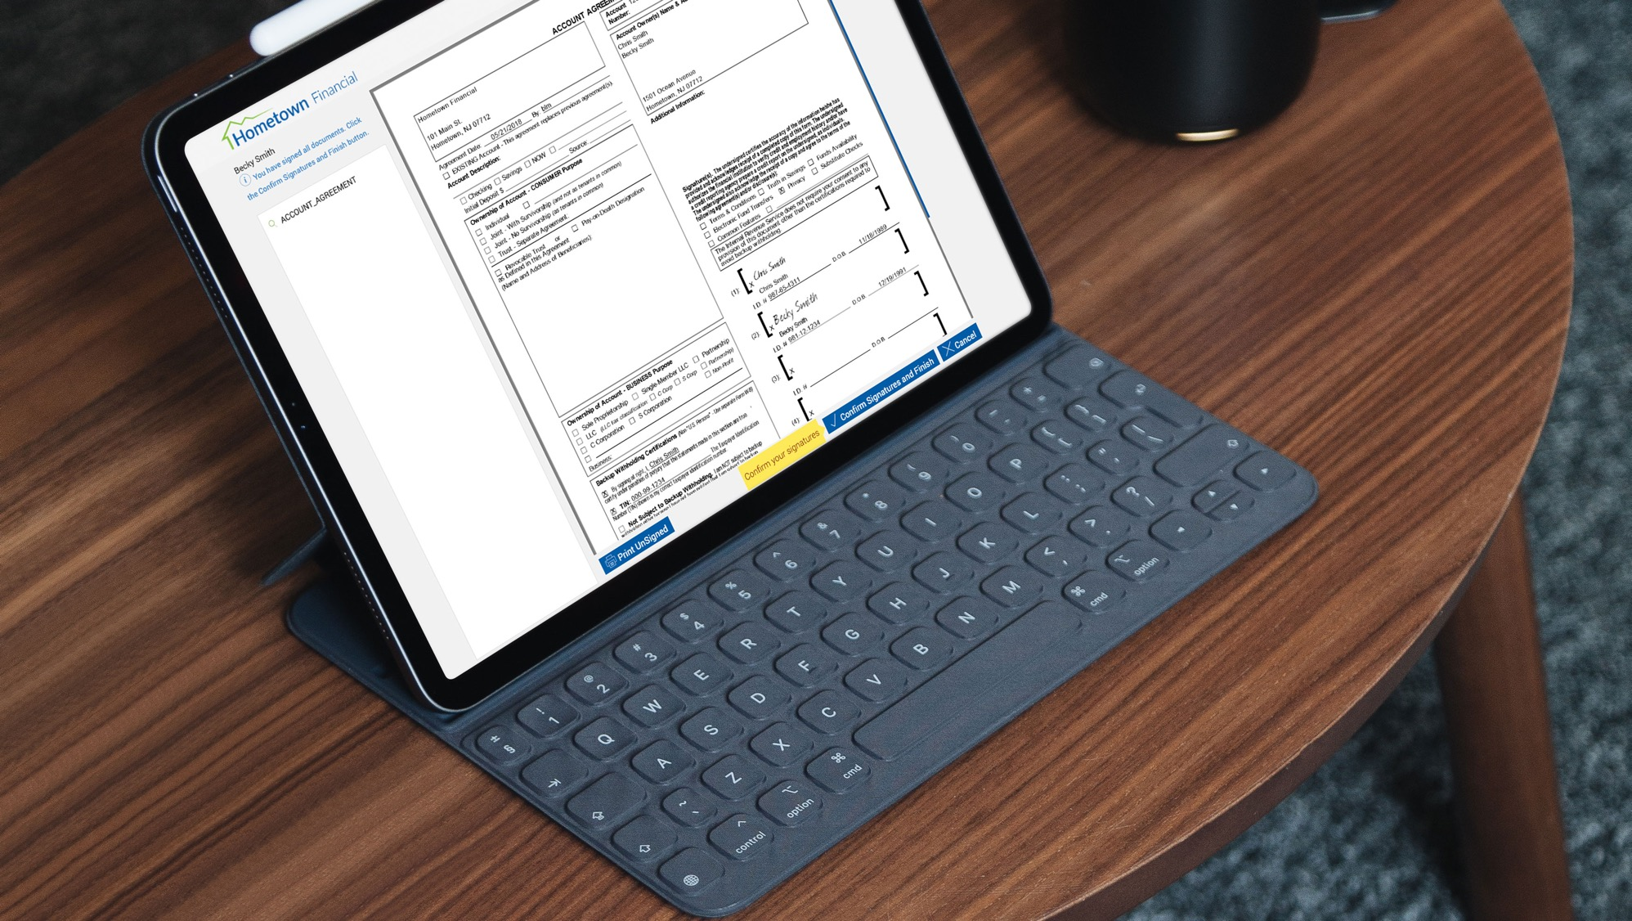
Quick Start Program

Slide 7

Quick Start eSign Program
Enables Sending Documents for Electronic Signature
  Rapid Deployment Model
Provides the Ability:
  Upload Document(s)
  Designate Recipients
  Tag/Setup Document(s) for Signing
  Send
After Documents Signed by Consumer:
  Email Notification back to Sender (FI employee)
  Completed Documents Can Be Downloaded,
  Printed, or Viewed by Employee
Migration to Full IMM eSign Enterprise Available

Slide 8
Quick Start Training Options
Self-Start Video-based Training
  Provides:
    Webex Recorded Training Session
    Links to Tutorial Videos
  48 hour system availability from contract execution
  $250 fee for setup
Online Training Session
  Provides up to 4 hour session
    (Normal time is 2 to 2.5 hours)
  Conducted by IMM team
  Train the Trainer Concept
  Covers Administration and User Topics
  Training scheduled within 5 days of contract execution
  $900 fee
Access to IMM Support Center after Training

Slide 9
Ad-Hoc Processing
Enter Signer Information
Tag/Define
Document
Authentication
& Consent

Slide 10
Send via Pre-Established Template
Template
Authentication
& Consent

Slide 11
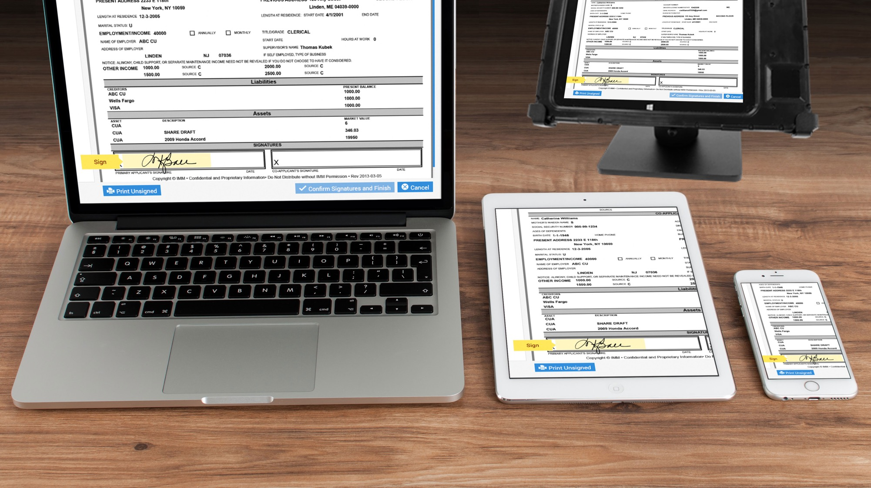
Easy Remote Document Signing

Slide 12
Remote Signer Authentication
+
Email
Password
KBA
Phone

Slide 13

Quick Start Demonstration

Slide 14

What Could We Answer

Slide 15




Thank You for Joining Us Today
Follow Us @IMMeSign

Slide 16
*DO NOT DELETE*
Gilroy Light
Gilroy Light Italic
Gilroy Regular
Gilroy Regular Italic
Gilroy Medium
Gilroy Medium Italic
Gilroy Semibold
Gilroy Semibold Italic
Gilroy Bold
Gilroy Bold Italic
Gilroy Extra Bold
Gilroy Extra Bold Italic

